Slide 1
Project Update
15-20 slides

Slide 2
Overview
Items completed
Items partially completed
Items to be implemented
All Changes
Issues

Slide 3
Items Completed
All Onboarding Features
Login Form
Registration Form
Reset Password Form
Error Messaging and Validation
Routes to the following pages
Main Dashboard
Login
Forgot Password
Register
Password Reset
Profile
Completed Projects
Create Project
Library

Slide 4
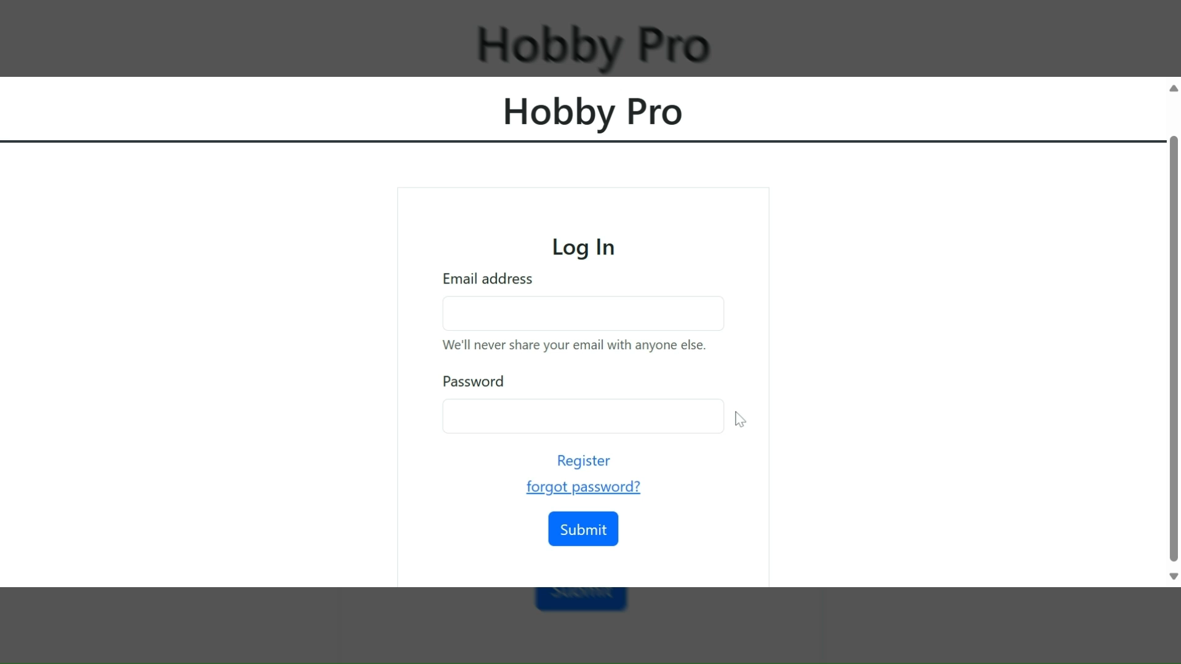

Slide 5
Items Partially Completed
Basic layout and color scheme is done
CSS still being experimented with to handle desktop and mobile view
Sort and Filter buttons are available, but functionality has not been implemented
Most of the database is implemented. Still possibility of change as Tasks subcollection is added to the project.
This includes
Main Dashboard
Navigation Bar
Create New Project Page
Library

Slide 6
Items Partially Completed
Main Dashboard
Progress bar on Project Icon
Be functional once Stages are developed
Some routes are in progress
Project accessed by id
Stages accessed by project
Navigation Bar
Some implementations for individual project page traversal
SVG icons next to each tab
Create New Project Page
Adding tag names
Adding a deadline

Slide 7
Items Partially Completed
Library
Functionality to update and delete files and folders still needed
Refine the view to be more intuitive
Completed Projects
Project Icon's grid layout needs to be adjusted to handle desktop and mobile view
Database
Add Tasks subcollection to Stages subcollection.
Storage
Rudimentary functionality to create Files and directories.

Slide 8
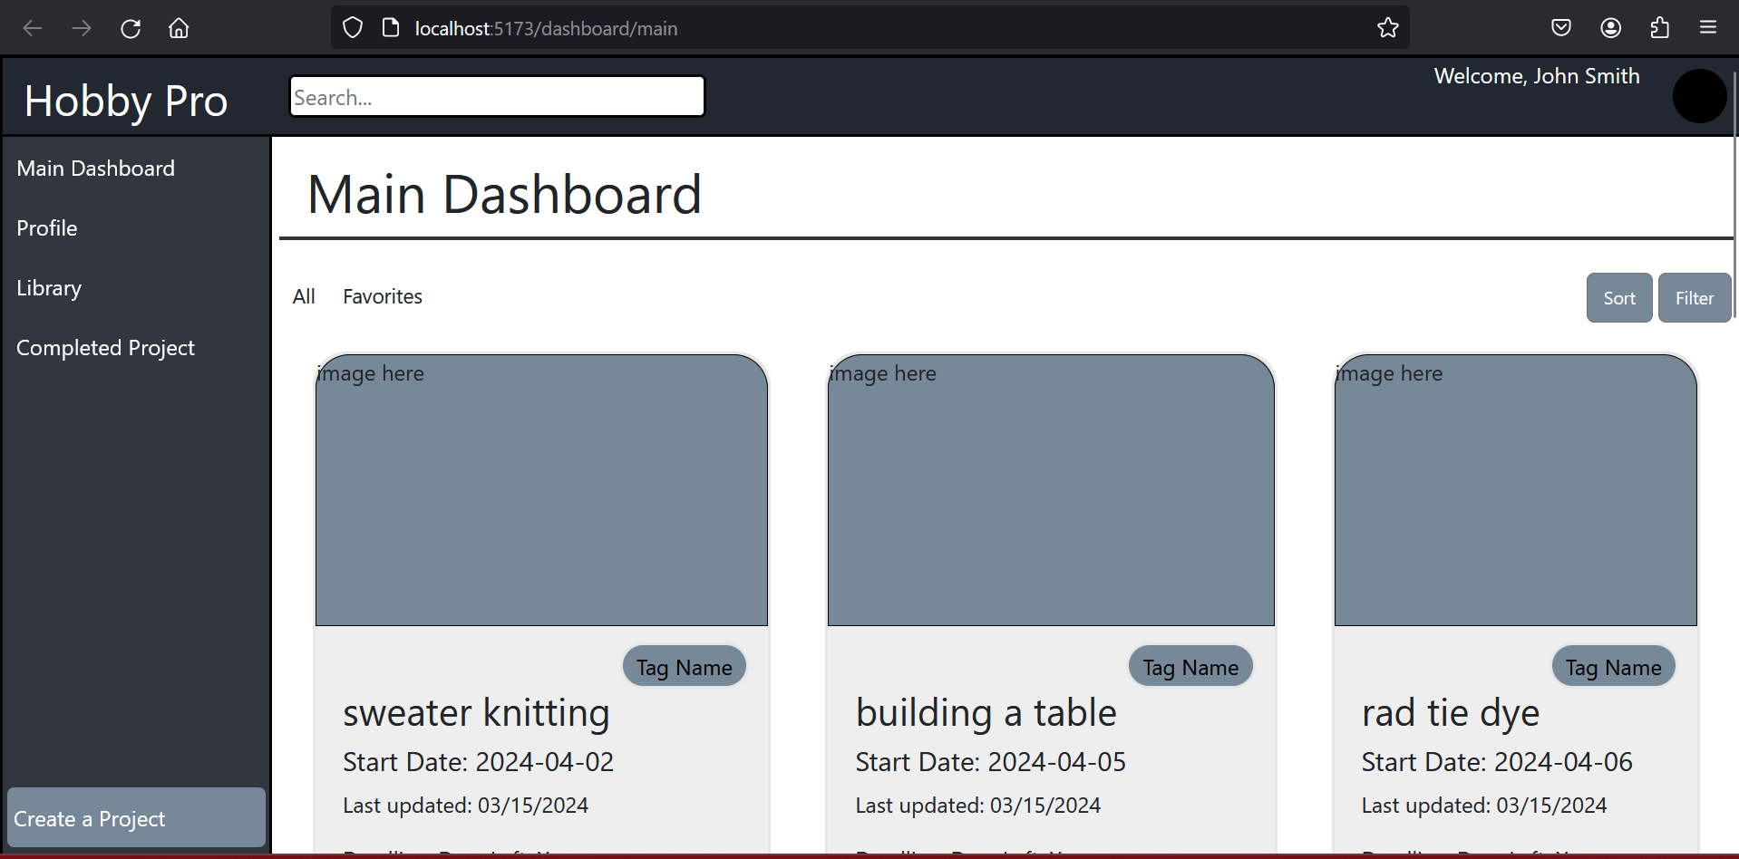

Slide 9
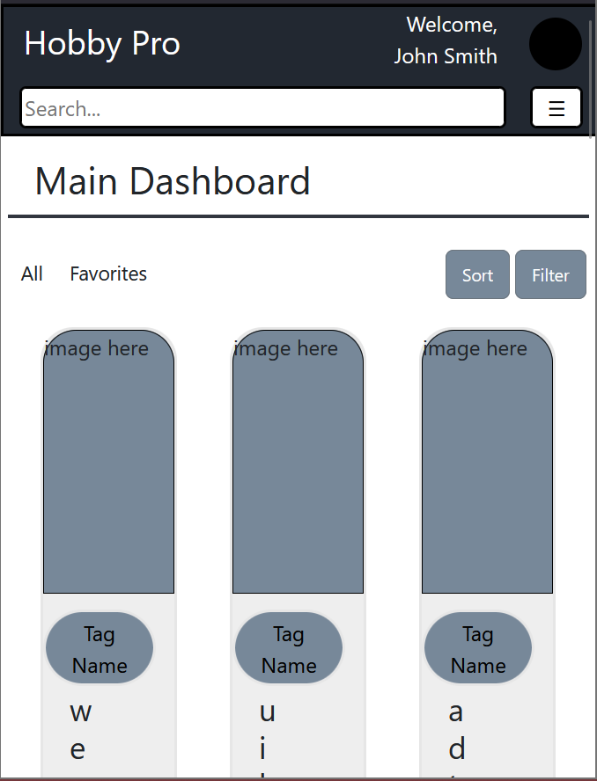
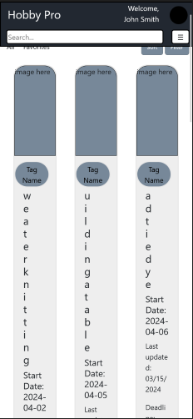

Slide 10
Items to be Implemented
The following needs to be implemented:
User Profile
Project Details page
Stages Page

Slide 11
Items to be implemented
User Profile:
Page is available but is not developed
Projects Details Page:
Page is available but is not developed as functionality to access is recent
Will also have functionality with navigation for its own purposes
Stages Page
Not added

Slide 12
All Changes
Design of Onboarding
The design colors of onboarding were originally gray.
Now it’s a white color with red error text for errors.
Quick access features
Removed from original requirements.
This was due to state of the project and time constraints
Two separate page are now one
The ability to favorite a project is removed

Slide 13
Issues
Firebase will allow you to create an empty directory but will not let you access said directory until it has data inside of it.
Application wide state must be maintained to keep track of current directories
Still working out how Firebase's storge works for pictures and documents.

Slide 14
Updated Diagrams

Slide 15
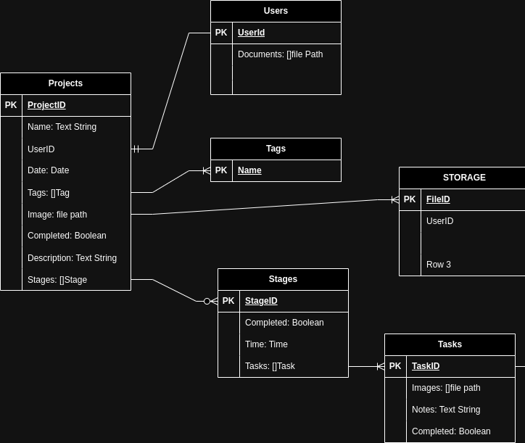
Database changes
This is what the original design of our database looked like.
BEFORE

Slide 16
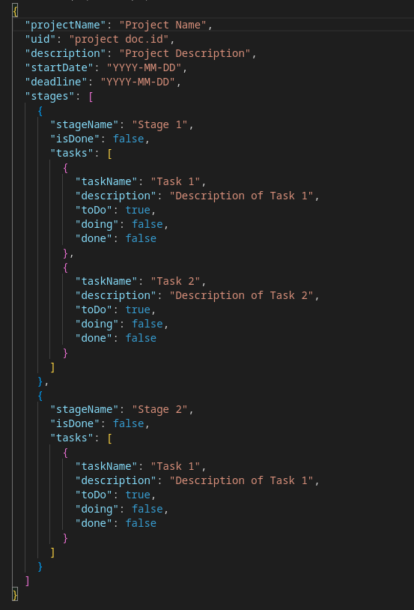
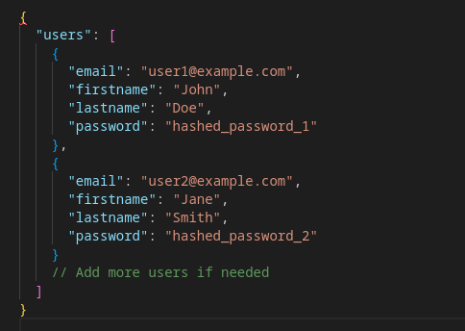
AFTER
On the left is the updated Json representation of our database for our Projects, and above is the updated Json of our users

Slide 17
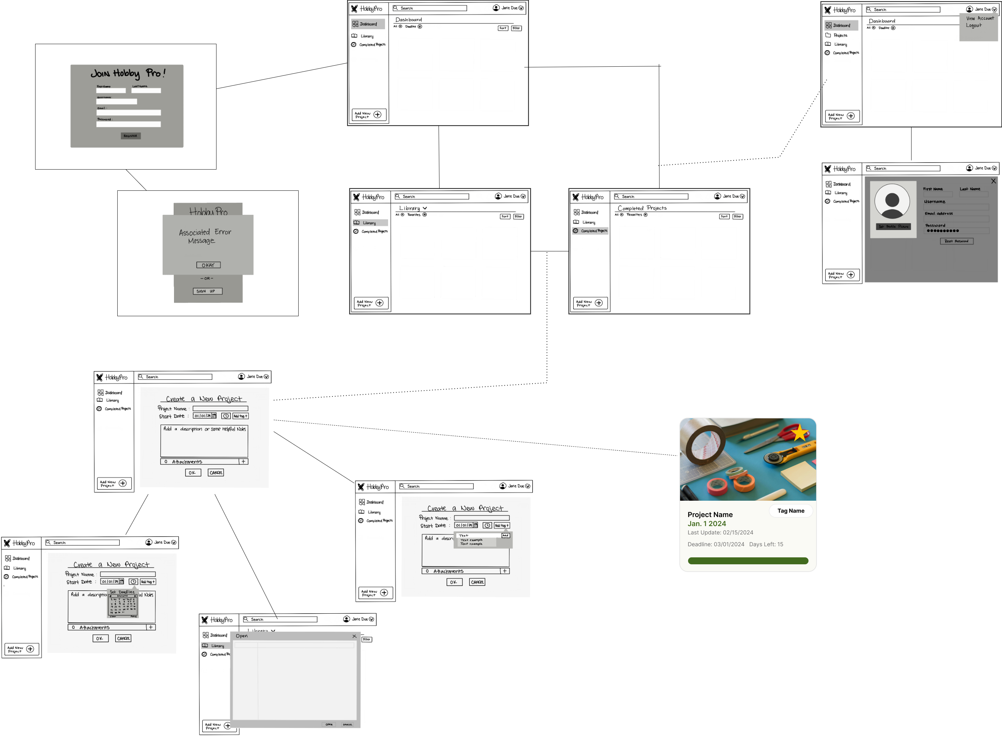

Slide 18
Thank you!

